Slide 1
Comprehensive Digital Marketing
Project Work
on
APOLLO HOSPITALS

Slide 2
TEAM MEMBERS
B.N.V.S. Siddartha [TEAM LEADER]
B. Tarun Chowdary
B. Vikas
D. Bhanu Prakash
N. Bhavya Sri

Slide 3


Slide 4
Part 1: Brand study, Competitor Analysis & Buyer’s/Audience’s Persona
●Research Brand Identity: Study the brand's mission, values, vision, and unique selling propositions (USPs).
Mission: “Our mission is to bring healthcare of International standards within the reach of every individual. We are committed to achieving and maintaining excellence in education, research, and healthcare for the benefit of humanity”.
Vision: Apollo’s vision for the next development phase is to ‘Touch a Billion Lives.’
USP: The cornerstones of Apollo's legacy are its unstinting focus on clinical excellence, affordable costs, modern technology, and forward-looking research & academics.

Slide 5
Value: Values make us who we are, defining us not only as individuals but also as a family. Apollo has always been a family, working together, crossing hurdles, and notching up victories together. Our values hold us and unite us for a common purpose. It upholds what we believe in and holds close to our hearts, making Apollo one of the most excellent healthcare providers in the world.
Pioneering Attitude: Stay ahead of the curve by constantly creating innovative solutions for the well-being of our patients and society.
Proactive Involvement: Always look for ways to add value to everything we do by going the extra mile.
World Class Excellence: Continuously strive for excellence in all spheres - clinical, financial, operational, and service or people management, by benchmarking our processes and procedures with best in class models available.

Slide 6
●Analyze Brand Messaging: Apollo Hospitals is one of the leading healthcare providers in India and abroad. It has a mission to bring healthcare of international standards within the reach of every individual and a vision to touch a billion lives. Its tagline is “Touching Lives.”
Some of the aspects of its brand messaging are:
It emphasizes its quality, innovation, and trust as the pillars of its brand identity. It showcases its achievements, accreditations, awards, and testimonials to demonstrate its excellence and credibility.
It highlights its patient-centric approach and commitment to providing holistic and personalized care to every patient. It also showcases its social responsibility initiatives and its efforts to make healthcare accessible and affordable to all.
It leverages its diverse and integrated portfolio of services, ranging from primary care to specialty care, diagnostics to dialysis, dental to cradle, and wellness to transplants. It also offers telemedicine, e-health, home health, and health insurance services.

Slide 7

●Examine the brand's tagline:
Touching someone's life means making a positive change in someone's life; this change could change emotional state, physical situation, or much more.
By the tagline '"Touching lives, "Apollo Hospitals means building trust from their patients that they have a great chance of becoming better people after the treatment.
And also, they explained that Apollo Hospitals is open for any treatment like physical, mental, etc. The tagline " Touching Lives " refers to changing a person into a better person from physical illness or mental illness.

Slide 8
Competitor Analysis:
Competitor 1: Fortis Healthcare
USP: Fortis offers a full spectrum of integrated healthcare services ranging from clinics to quaternary care facilities and ancillary services.
Online Communication: It has a mission to create a world-class integrated healthcare delivery system, entailing the finest medical skills combined with compassionate patient care. Its tagline is “Saving and Enriching Lives.”
Competitor 2: KIMS Hospitals
USP: It has a solid and experienced team of doctors, nurses, technicians, and support staff committed to providing patients with the best medical care.
Online Communication: It has a user-friendly and informative website that provides information about its services, locations, doctors, specialties, health packages, health blogs, and more. It also allows users to book appointments, consult doctors online, order medicines, book lab tests, and access their health records.

Slide 9
Competitor 3: Global Health
USP: Their healthcare approach is holistic, covering not only patients' medical needs but also social, economic, and environmental factors that impact their health.
Online communication: organizations can offer solutions and innovations by raising awareness and visibility of the health issues and challenges faced by the populations they serve. They can also engage and inform various stakeholders, including donors, partners, policymakers, media, and the general public, about their work and impact.

Slide 10
Buyer's/Audience's Persona: The Apollo Hospital's target audience is people who need or want high-quality healthcare services in various domains such as primary care, specialty care, diagnostics, dialysis, dental, etc.
Some possible ways to define the target audience are:
Based on demographics, such as age, gender, income, region, and marital status. For example, Apollo Hospital may target middle-aged and elderly people who have higher health risks and needs, women who need maternity or gynecological care, high-income people who can afford premium services, urban and semi-urban people who have access to the hospital facilities, and married people who may have family health plans.
Based on psychographics, such as lifestyle, personality, values, and attitudes. For example, Apollo Hospital may target health-conscious and proactive people who seek preventive and wellness services, ambitious and career-oriented people who value their productivity and performance, socially responsible and ethical people who support the hospital’s mission and vision, and loyal and satisfied people who trust the hospital’s brand and reputation.

Slide 11
Based on behaviors, such as usage patterns, benefits sought, loyalty status, and buying readiness. For example, Apollo Hospital may target frequent and regular users of its services, people who seek specific uses such as quality, convenience, safety, or innovation, people who are loyal to the hospital or its doctors, and people who are ready to buy or book its services online or offline.
Based on interests, such as hobbies, passions, preferences, and needs. For example, Apollo Hospital may target people who are interested in health-related topics such as nutrition, fitness, wellness, or diseases, people who have passions or hobbies that require good health such as sports, travel, or arts; people who prefer personalized and customized services that suit their needs and expectations, and people who have specific or urgent health needs such as surgeries, transplants, or treatments.
These are some possible ways to define the target audience for the Apollo Hospital. However, it is essential to note that these are not mutually exclusive or exhaustive categories. The hospital may use a combination of these criteria to segment its market and identify its ideal customers. Moreover, the hospital may also conduct market research and analysis to validate its assumptions and refine its segmentation strategy.

Slide 12
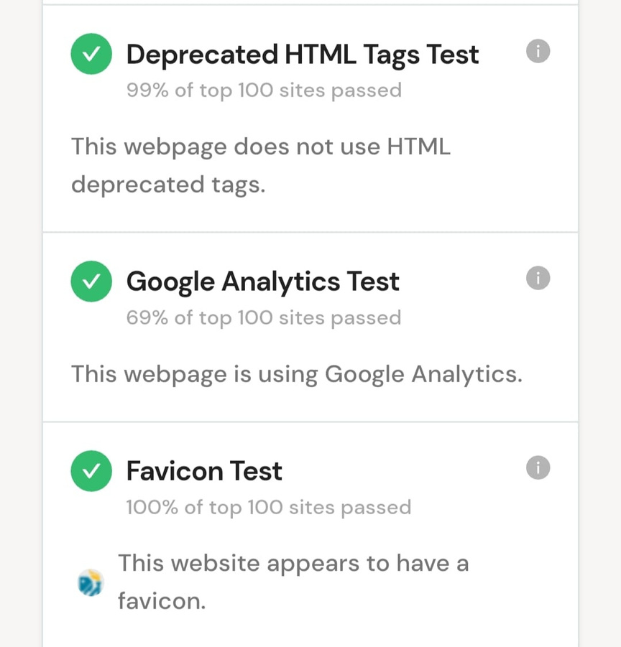
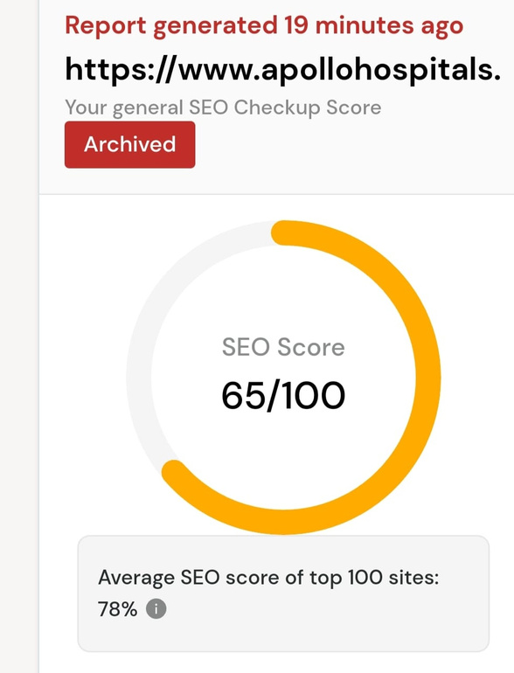
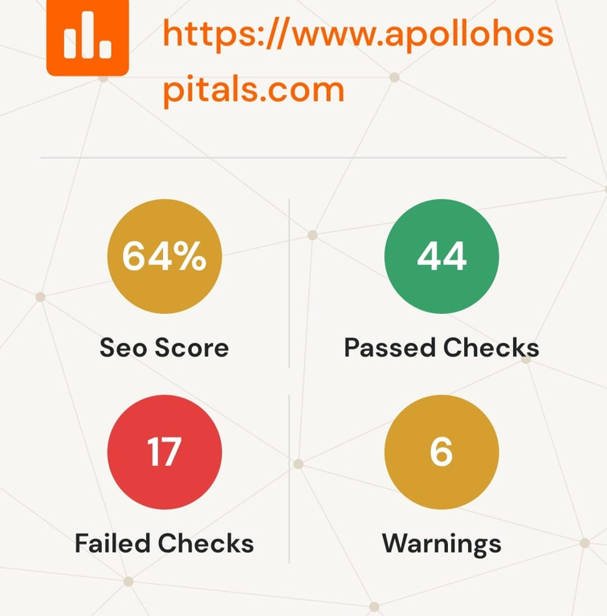
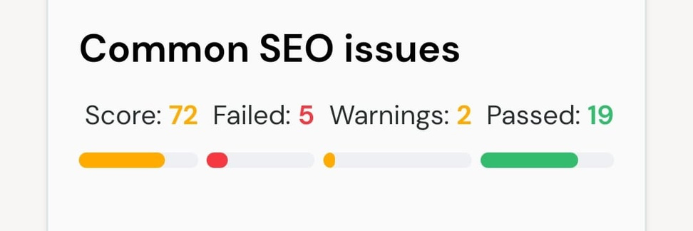
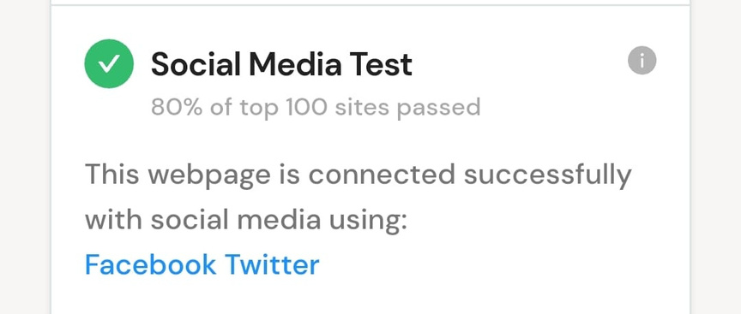
Part 2: SEO & Keyword Research
SEO AUDIT

Slide 13
META title test
This webpage uses a title tag with a length of 102 characters. While there's no target number of characters, titles should be descriptive and concise. We recommend using a title between 20 - 60 characters to fit Google Search results with a 600-pixel limit.
Text: Multispeciality Hospitals in India | Apollo Hospitals for all Your Healthcare Needs - Apollo Hospitals
Length: 102 characters
Meta Description Test
Text: Apollo Hospitals is the leading multispecialty health care unit with best in class treatments for cancer, knee replacements, liver transplant, heart, diabetes, kidney etc.
Length: 171 characters

Slide 14
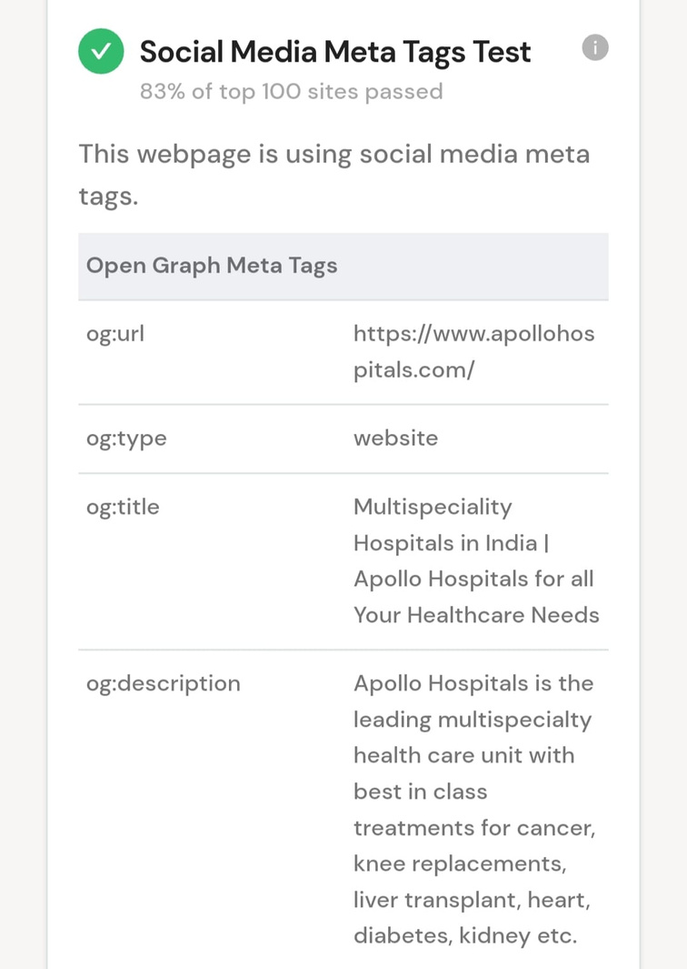
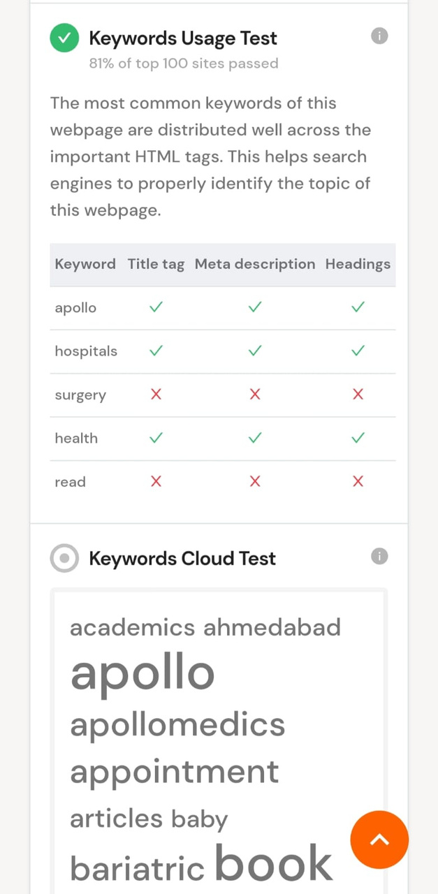
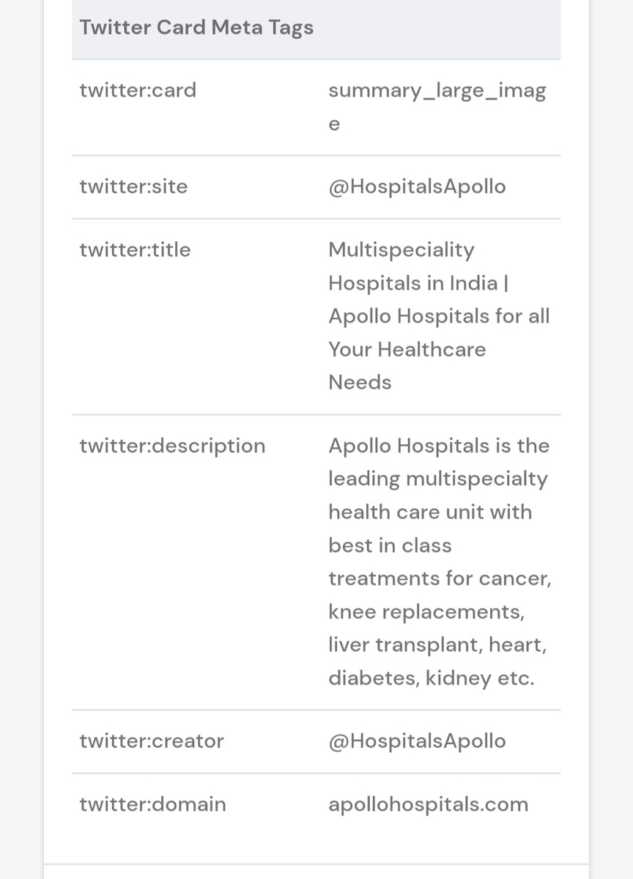
Results for Meta tag test

Slide 15
Keyword Research:
Keyword research involves identifying relevant keywords and phrases related to a particular topic or business to improve search engine optimization (SEO) and attract targeted traffic. For the Apollo Hospital, a prominent healthcare institution, the keyword research would focus on terms related to its services, locations, specialties, and other relevant aspects. Below are some potential keywords related to Apollo Hospital:
Apollo Hospital
Apollo Hospitals Group
Apollo Hospital locations
Apollo Hospital specialties
Apollo Hospital services
Apollo Hospital doctors
Apollo Hospital treatments
Apollo Hospital medical tourism

Slide 16
Apollo Hospital news
Apollo Hospital contact information
Apollo Hospital careers
Apollo Hospital technology
Apollo Hospital achievements
Apollo Hospital awards
Apollo Hospital facilities
Apollo Hospital insurance
Apollo Hospital research
Apollo Hospital COVID-19 response
Apollo Hospital healthcare services
Apollo Hospital patient reviews
Remember, the actual keyword selection will depend on the specific goals of the SEO strategy and the audience you want to target. It's crucial to use tools like Google Keyword Planner, SEMrush, or Ahrefs to refine and expand this list, considering factors like search volume, competition, and relevance.

Slide 17
ON PAGE OPTIMIZATION
Apollo Hospital is the leading multispecialty healthcare unit with best-in-class treatments for cancer, knee replacements, liver transplant, heart, diabetes, kidney, etc. Show less
Global Rank
#65,957
19,865
Country Rank
#5,412
1,735
India
[13:05, 7/25/2023] : Total Visits-896.8K
Bounce Rate-60.94%
Pages per Visit - 3.20
Avg Visit Duration - 00:05:05
Company - Apollo Hospitals - Year Founded - 1983 - Employees - 10001
HQ - India, RajaAnnamalaipuram - Annual Revenue - $1.0B - Industry - Health > Medicine

Slide 18
apollohospitals.com Ranking
Website ranking helps evaluate the value of a business. Over the last three months, apollohospitals.com global scale has increased from 90,291 to 65,957.
Geography & Country Targeting
Which countries sent the most traffic to apollohospitals.com lately? Where is their core audience from? Last month India was the top country sending desktop traffic to apollohospitals.com
Top Countries
India >82.44%>31.39%
Bangladesh>6.46%>45.69%
United States>3.49%>55.90%
United Kingdom>0.96%>52.55%
Germany>0.88%>661.1%
Others>5.77%

Slide 19
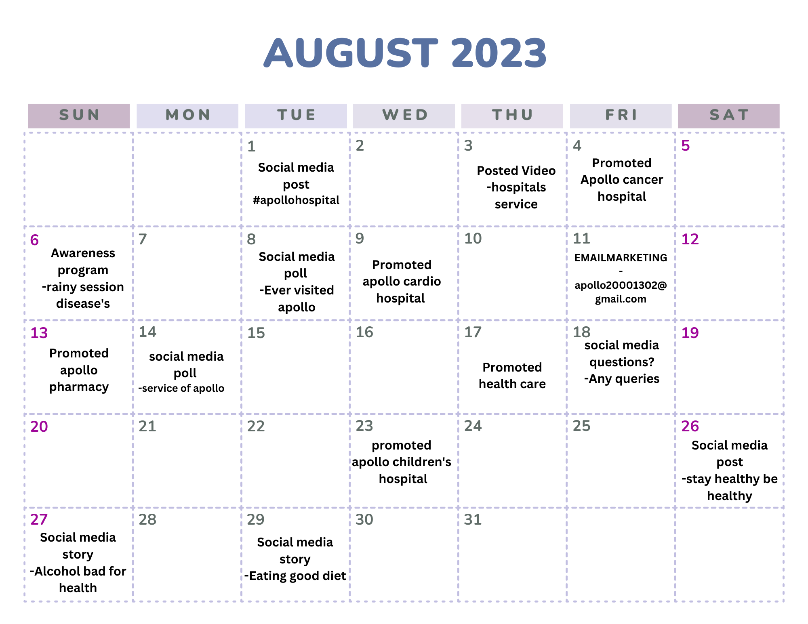
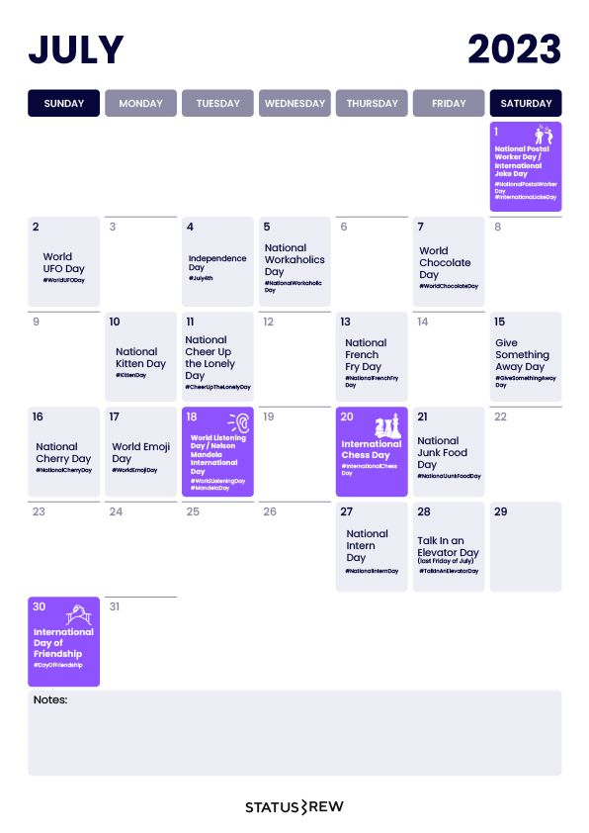
Part 3: Content Ideas and Marketing Strategies

Slide 20
Content ideas:
You can create content that showcases the success stories of Apollo Hospitals’ patients, doctors, and staff. For example, You can share stories of patients who underwent complex surgeries or doctors who performed breakthrough procedures. Additionally, you can showcase staff members who have gone above and beyond to provide excellent service to patients. These stories help emphasize the quality, trust, and care that Apollo Hospitals provides to its customers.
You can also create content that educates the audience about the latest technologies and innovations that Apollo Hospitals uses to deliver world-class healthcare. For example, could you please explain how Apollo Hospitals uses robotics, information technology, and artificial intelligence to ensure that processes are perfect? You can also showcase how Apollo Hospitals provides an integrated value-chain delivery model that covers a wide range of wellness and medical services. These content pieces can demonstrate the expertise, efficiency, and excellence of Apollo Hospitals.
Another idea is to create content that inspires the audience to adopt a healthy lifestyle and prevent diseases. For example, you can share nutrition, fitness, mental health, and hygiene tips. You can also promote Apollo Hospitals’ preventive health check-ups, wellness programs, and telemedicine services. These content pieces can convey the mission, vision, and values of Apollo Hospitals.

Slide 21
Marketing strategies:
One marketing strategy uses digital marketing channels such as social media, email, website, blog, podcast, video, and mobile app to reach your target audience. You can use these channels to share your content ideas, engage with your customers, generate leads, and increase conversions. You can also use these channels to collect feedback, measure performance, and optimize your campaigns.
Another marketing strategy is to use offline marketing channels such as print media, radio, television, outdoor advertising, events, and word-of-mouth to create awareness and trust among your potential customers. You can use these channels to showcase your brand image, communicate your unique selling proposition, and differentiate yourself from your competitors. You can also use these channels to build relationships, loyalty, and referrals among your existing customers.
A third marketing strategy is to use partnership marketing channels such as associations, influencers, celebrities, NGOs, and government agencies to expand your reach and influence among your niche markets. You can use these channels to leverage your partners' credibility, reputation, and network. You can also use these channels to create social impact, goodwill, and advocacy for your brand.

Slide 22
Lessons learned:
We learned about the various strategies for digital marketing which the companies are using.
We also learned about the companies which are using these strategies to lead the market.
We also gained knowledge about how to plan and use these strategies according to the global trend.
Challenges encountered:
We encountered some issues related to the strategies used by the companies being leaked or used by the competitors.
Only some of the companies are using digital marketing as their promotion strategy which may or may not reach all the audience.
Most companies are not maintaining their websites properly, which leads to the website traffic

Slide 23

Part 4: Content Creation and Curation (Post creations, Designs/Video Editing, Ad Campaigns over Social Media, and Email Ideation and Creation)
Post Creation:
Format 1 - Blog article
Aim:- To bring more customers.
Date:- 27/07/2023
Idea:- Making people know about the Apollo
hospitals.
Topic:- Taking care of your health.

Slide 24
Post Creation:
Format 2 – Videos
Aim:- To gain customers’ loyalty.
Date:- 27/07/2023
Idea:- customers to see how Apollo takes care of you.
Topic:- How Apollo service is.
Google Drive link:-
https://drive.google.com/file/d/10F7ThtrtRT7cDMEEJKcKQKM09ukgaoeU/view?usp=sharing

Slide 25
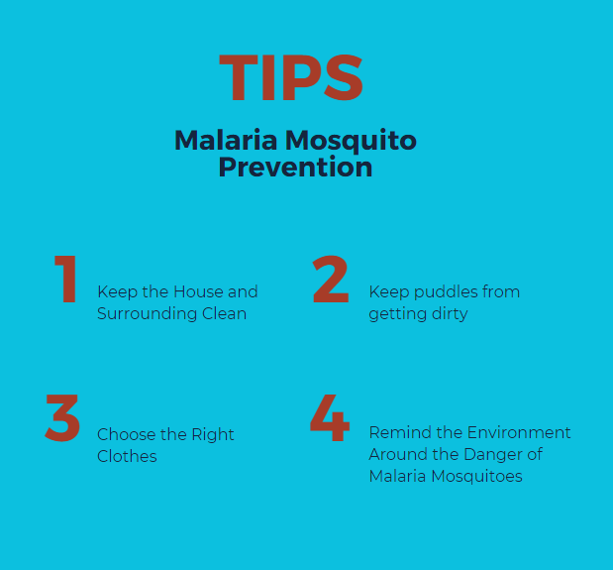
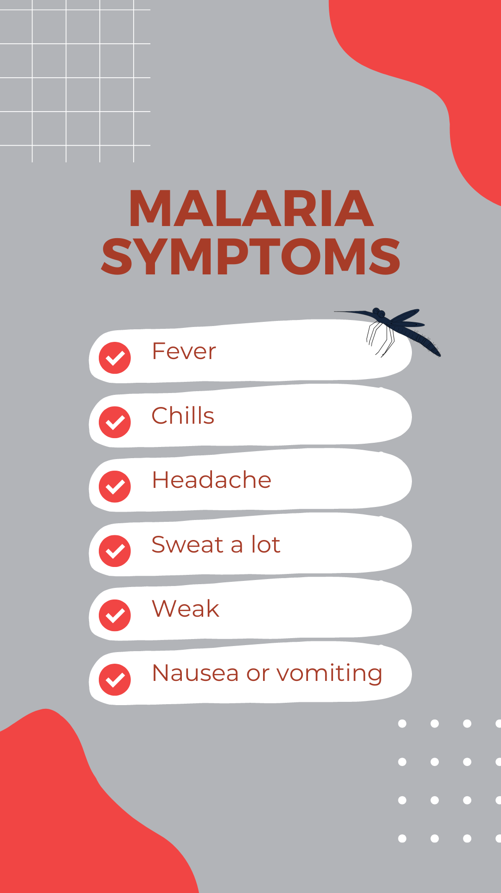
Post Creation:
Format 3 – post
Aim:- To ensure that individuals with a fever are tested.
Date:- 27/07/2023
Idea:- Make people get tested when they get a
fever, due to the monsoon season they may
get affected by Dengue, Malaria, etc.
Topic:- Be safe.

Slide 26
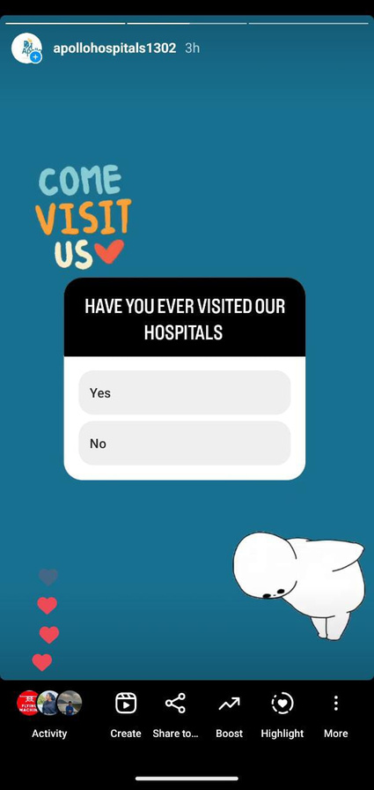
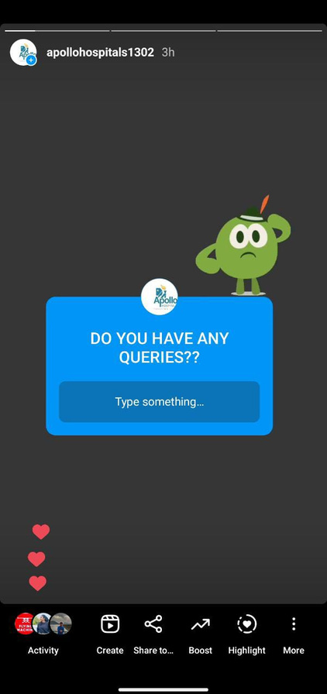
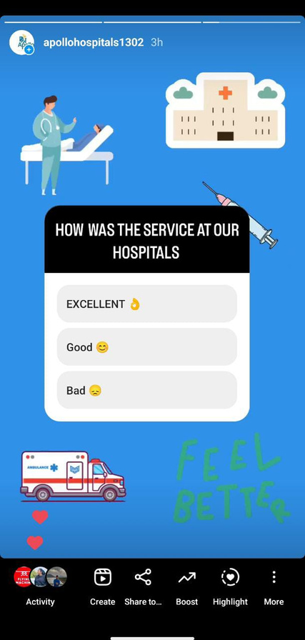
Instagram Story

Slide 27
Designs/Video Editing
INSTAGRAM LINK
https://www.instagram.com/reel/CvSESKdMHjg/?igshid=MTc4MmM1YmI2Ng==
GOOGLE DRIVE LINK
https://drive.google.com/file/d/10FzAJYnnSbkHAAyoT9jQ6ze96fwX2BOR/view?usp=drive_link

Slide 28
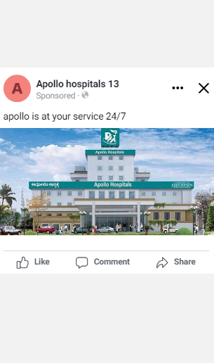
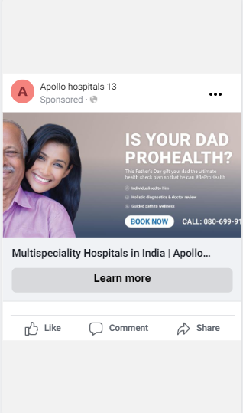
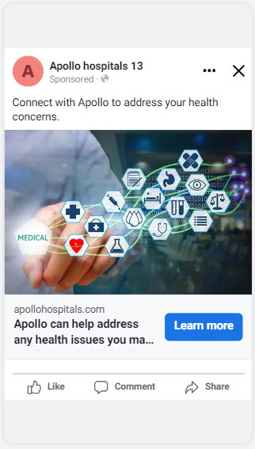
Social Media Ad Campaigns
Brand Awarenesss
Generating leads
Driving website traffic

Slide 29
Advertising Goals: To increase brand awareness by reaching a diverse audience and boosting visibility.
This could attract potential customers who may need to become more familiar with the brand.
Audience Targeting: Defining the target audience for a social media advertising campaign is crucial to ensure that marketing efforts effectively reach people with a high potential interest in the brand's products and services.
Demographics - All age groups visit Apollo hospitals all over India, mainly young adults and middle-aged adults visiting the Apollo hospitals for treatment.
Interests -
Health: It can target people interested in health and wellness. This includes people looking for information about specific health conditions, people trying to improve their overall health, and people looking for preventive care.

Slide 30
Technology: It can target people who are interested in technology. This includes people looking for the latest medical technology, people interested in using technology to improve their health, and people working in the healthcare technology industry.
Social media: It can target active people on social media. This includes people who follow healthcare-related hashtags, people who like and share healthcare-related content, and those who are active in online communities.
Behavior -
Search: Apollo Hospitals can target people searching for healthcare information online. This includes people who are searching for specific health conditions, people who are looking for preventive care, and people who are comparing healthcare providers.
Social media: Apollo Hospitals can target active people on social media. This includes people who follow healthcare-related hashtags, people who like and share healthcare-related content, and those who are active in online communities.

Slide 31
Website traffic: Apollo Hospitals can target people who have visited their website in the past. This includes people who have visited their website for information about specific health conditions, requested a quote, and signed up for their email list.
Email: Apollo Hospitals can target people who have subscribed to their email list. This includes people who have opened their emails in the past, people who have clicked on links in their emails, and those who have responded to them.
Ad Creation: Image-based ad creatives can effectively drive website traffic.
Visual Appeal [Image-based]
Take an image of a group of doctors. Who is wearing white coats and attending the patents?
Ad copy: At Apollo Hospitals, we prioritize your health. We offer many services to help you stay healthy. From preventive care to specialized treatment, we're here to help you live your healthiest life.
Call to action: Visit our website or call us today to book an appointment.

Slide 32
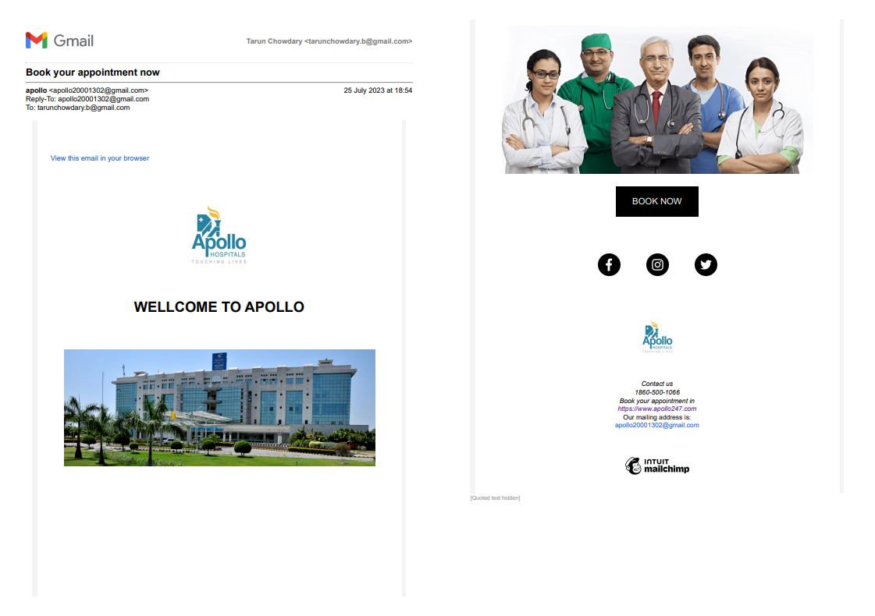
Email Ad Campaign 1 - Brand Awareness

Slide 33
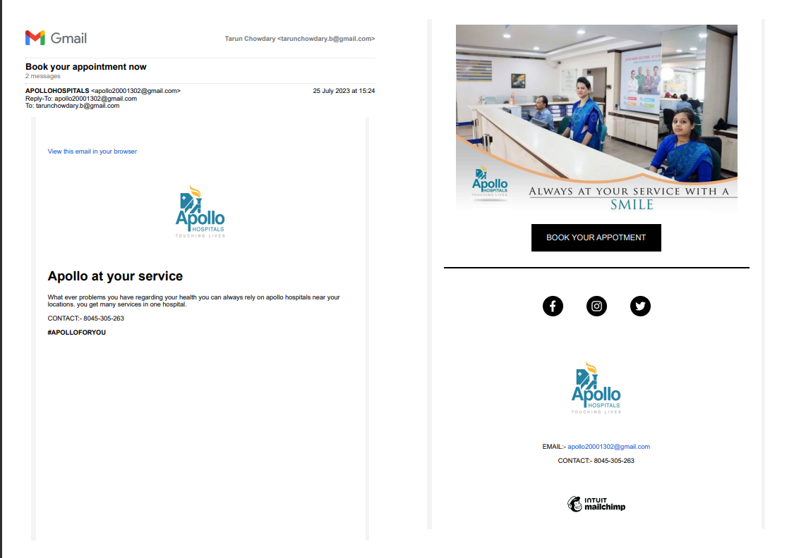
Email Ad Campaign 2 - Lead Generation

Slide 34
Lessons learned:
We learned how to create social media business accounts and promote the product and services of a brand.
We also discovered how it has become easier to connect with the audience and share updates in less time.
We also understood that many companies are investing more in digital marketing to reach people.
Challenges encountered:
We encountered many challenges while making social media ads there are fewer apps that can give a better experience in making the ads.
We also encountered a few of the companies that are not using attractive ad campaigns.
Few of them are misguiding the people by not showing original information.
Many of them are not maintaining their website information updated, so many people can’t know about the current product and services provided by companies until they visit their stores.

